Slide 1
Learning Goals/Objectives
Be able to read, comprehend, trace, adapt and create Python code using selection that:
Uses Boolean operators with multiple conditions.
Checks if a number is inside or outside a range.
Nests selection statements inside each other.

Slide 2
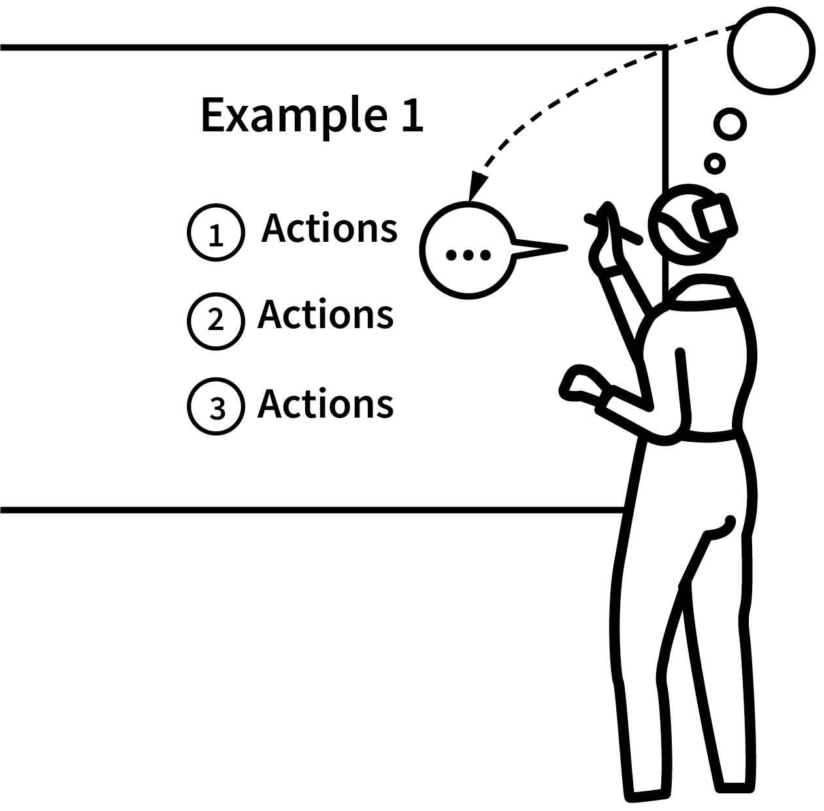
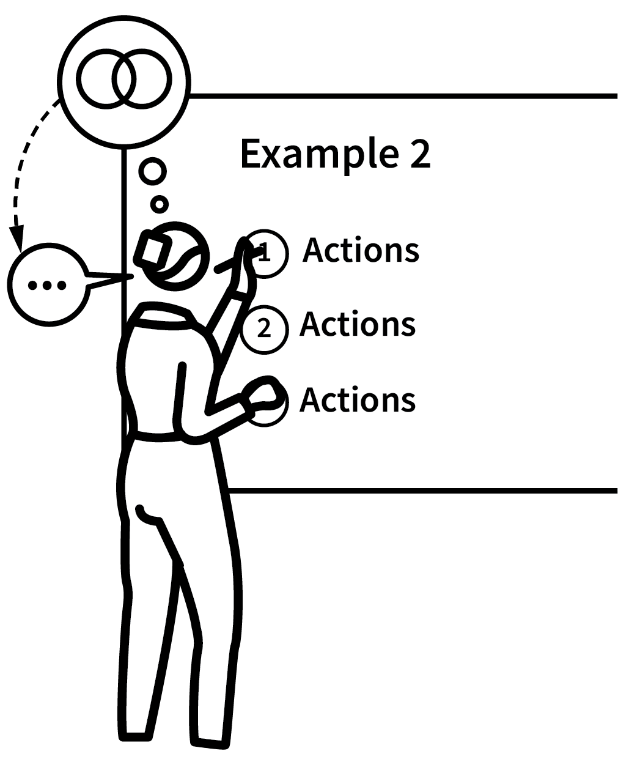
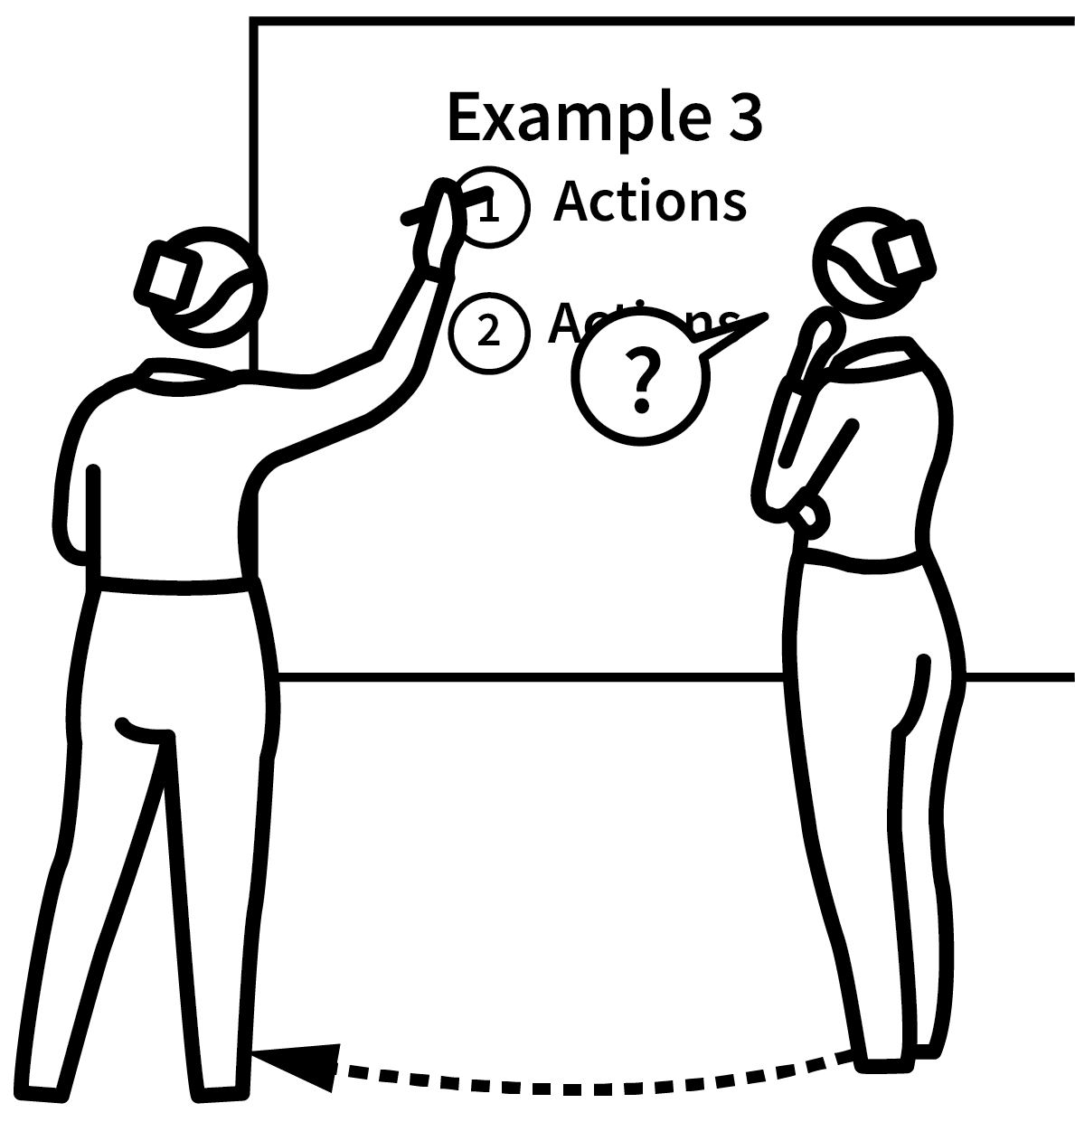
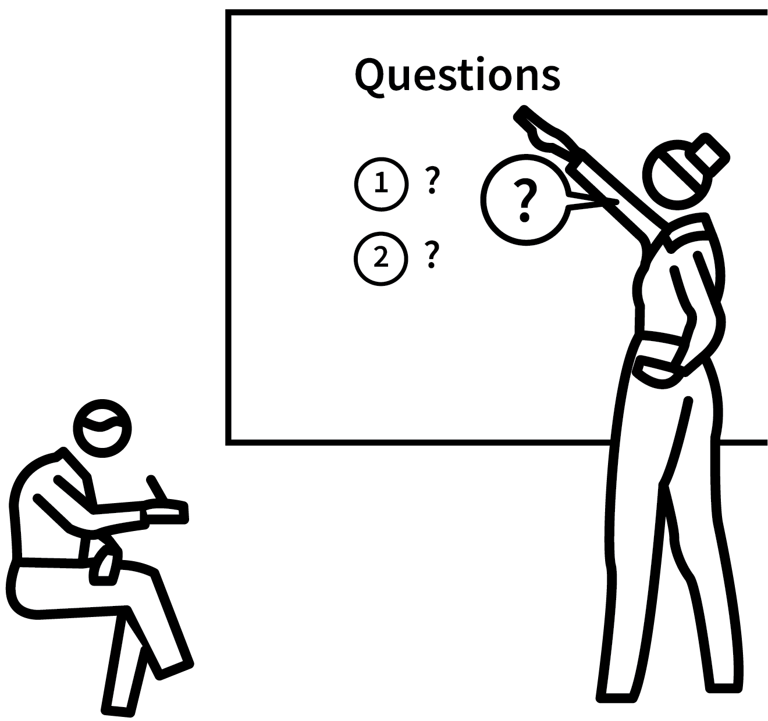

HOW THE TASKS HELP YOU DEVELOP YOUR SKILLS
FULLY WORKED TO INTRODUCE THE METHOD OR IDEAS
FULLY WORKED FOR REINFORCEMENT
PARTIALLY WORKED FOR STUDENTS TO FINISH OFF
CUED START FOR STUDENT COMPLETION
COMPLETED INDEPENDENTLY
PREDICT & RUN INVESTIGATE MODIFY MAKE
NOT MY CODE
PARTLY MY CODE
ALL MY CODE

Slide 3
More than one Boolean Operator

Slide 4
Boolean Operators
and - Checks at least two conditions. Returns true if all conditions are true
if hair == ‘brown’ and eyes == ‘brown’:
Stand up
else:
Sit down
if hair != ‘brown’ and hasPet == false:
Stand up
else:
Sit down
if hair == ‘blonde’ and eyes != ‘blue’ and hasPet == true:
Stand up
else:
Sit down
if hair == ‘brown’ and hasPet == true:
Stand up
else:
Sit down
Notes:
Guess Who is a great game to use as an example here.
You can use a boolean operator to check more than one condition.
Use the ‘stand up if’ with your classes to show that both conditions must be true to qualify to stand up.

Slide 5
Boolean Operators
or - Checks at least two conditions. Returns true if at least one condition is true
if hair == ‘brown’ or eyes == ‘brown’:
Stand up
else:
Sit down
if hair == ‘brown’ or hasPet == true:
Stand up
else:
Sit down
if hair != ‘brown’ or hasPet == false:
Stand up
else:
Sit down
if hair == ‘blonde’ or eyes != ‘blue’ or hasPet == true:
Stand up
else:
Sit down

Slide 6
Boolean Operators
not - Inverts the value from the condition. Returns false if the condition is true and true if the condition is false.
if not(hair != ‘brown’)
Stand up
else:
Sit down
if not (hair == ‘brown’):
Stand up
else:
Sit down

Slide 7
Multiple Booleans - How To Code
Use and or or between the conditions.
Set your data, either by assignment or input.
num1 = 23
if num1 < 50 and num1 < 100:
2. Put the Boolean operator between the conditions in your code
Notes:
Condition 1 is on the left of the and
Condition 2 is on the right
You can use as many conditions as you like, just separate them with a Boolean operator each time.

Slide 8
Numbers in a Range (Validation)
Notes:
No further examples here, the one on slide 2 and in the repls are more than enough. We are just using the print command inside the functions.

Slide 9
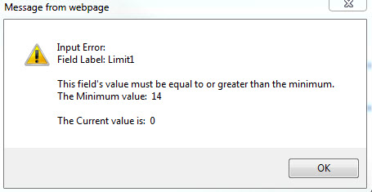
Validation
Checking whether data entered is reasonable, sensible and allowable.
Sometimes you only want to allow the user to input certain numbers.
We can use selection and Boolean conditions to produce error messages if they don’t.
Notes:
Remind students what a range is.
Link to maths.

Slide 10
Validation inside a range - how to code
Using selection will allow you to create success/error messages. It won’t make the user try again - we’re building up to that.
Get the input.
num1 = input(“Enter a number between 1 and 10”)
if num1 >= 1 and num1 <= 10:
print(“Number in range”)
else:
print(“Number not in range”)
3. Success message if it is in the range. Error message if not.
3. Success message if it is in the range. Else error message.
2. Use >= the lowest allowable number and <= the highest allowable number.

Slide 11
Validation outside a range - how to code
Using selection will allow you to create success/error messages. It won’t make the user try again - we’re building up to that.
Get the input.
num1 = input(“Enter a number between 1 and 10”)
if num1 < 1 or num1 > 10:
print(“Number not in range”)
else:
print(“Number in range”)
3. Success message if it is in the range. Error message if not.
3. Error message if it is not in the range. Else success message.
2. Use < the lowest allowable number or > the highest allowable number.
Notes:
Point out that it would be impossible for a number to be < 1 and >10 at the same time. This is why we use or. The number only needs to be outside the upper or the lower limits of the range, not both.

Slide 12
Nesting
Notes:
No further examples here, the one on slide 2 and in the repls are more than enough. We are just using the print command inside the functions.

Slide 13
Nesting
Nesting is putting programming structures inside each other.
For example, an if inside an if.
num1 = 53
if num1 > 10:
print(“More than 10”)
if num1 > 30:
print(“ and more than 30”)
else:
print(“ but not more than 30”)

Slide 14

Nesting Selection - How To Code
Create your first selection statement as normal.
num1 = 53
if num1 > 10:
print(“More than 10”)
if num1 > 30:
print(“ and more than 30”)
else:
print(“ but not more than 30”)
2. Nest the next statement inside the fist by using ‘Tab’ to indent it.
TAB
3. This statement will only run if the condition in the first ‘if’ is true.
Notes:
Spend some time tracing this so that pupils understand that the program will only move to the second ‘if’ if the condition for the first is true.
Use the python visualiser to help with this - paste the code in and students can see it running http://pythontutor.com/visualize.html#mode=edit

